Slide 1

COLLEGE FEST ORGANIZER
SLC’S INSTITUTE OF ENGINEERING AND TECHNOLOGY
UNDER THE GUIDANCE: PRESENTED BY:
Mr.A.Ramesh T.Nishma(10S31A0538)
Assoc.Prof,CSE K.Srinath(10S31A0550)
G.Sreekanth Raj(10S31AO549)

Slide 2
CONTENTS:
Introduction
Functionalities
Existing and proposed systems
Technology used s/w and h/w
Diagrams
Screen shots
Conclusion
References

Slide 3
INTRODUCTION
The purpose of College Fest Organizer is to provide an interface for the committee organizing a fest in the college to select volunteers and assign them to various events and also to upload and share various files either audio/video related to the events with the volunteers.
The volunteers can upload and download the files from the server. Volunteers create schedules for events.
The volunteers can post the events to be held on the site which can be viewed by all. The Organizers can assign students to various events and upload files related to various events.

Slide 4
FUNCTIONALITIES
Security Module: This module provides the authentication for the users. This module contains the registration page, login page .In this module the user is provided with a username and password
Event Organizer Module: In this module, the event organizer can post a new event and furnish various details related to that event and assign volunteers. The Event Organizer can also update or modify details related to the posted event. The can upload files related to events and can also play and download them
File Management Module: In this module the user is allowed to upload contents which can be documents or video files. In this module the user can download the files and also play the files online. The files are saved on the folder on the server.

Slide 5
Existing and Proposed System
Existing System
Fest is organized in almost all the colleges but all the work is done manually. The events are decided upon and then students are asked whether they will volunteer or not then all the details are maintained in files.
Many colleges have websites for fest that they organize in their colleges but this website is used for displaying the various events details that are going to be conducted in those colleges for informing the other college students.
Proposed System
The proposed system aims at providing the students and organizers a common platform to share files related to the events.
The organizers can also register and post the event detail and they can even select volunteers for the event. The organizers can also upload and download files related to the events.
This system allows students who want to volunteer to register with the application and view the various events that are to be conducted.

Slide 6
Software & Hardware Requirements
Windows as Operating System.
HTML, Cascading Style Sheets and JavaScript as Front-End designing tools.
MySql is used as Database Server. Tomcat 6.0 server is the Web server.
Java, JSP and Servlets are used as server side languages.
Hardware Requirements are P2 above processor, 128MB+ of main memory (RAM) and 100MB hard disk and data base memory.

Slide 7
DATA FLOW DIAGRAMS
College Fest
Organizer
Volunteer
DFD for Volunteer
College Fest
Organizer
Organizer
DFD for Organizer

Slide 8
Post
An
Event
Event DB
Organizer
Update
Event
Event DB
Upload
Files
File DB
Level-1 DFD diagram for Organizer

Slide 9
E-R DIAGRAMS
Register for
Users
Fest Events
Users
Upload
Files
Event Manager
Posts
Fest Events

Slide 10
UML DIAGRAMS
Usecase diagram for Event Organizer

Slide 11
Usecase diagram for Volunteer

Slide 12
Class diagram for College Fest Diagram

Slide 13
Sequence Diagram for Fest Organizer

Slide 14
Sequence Diagram for Volunteer

Slide 15
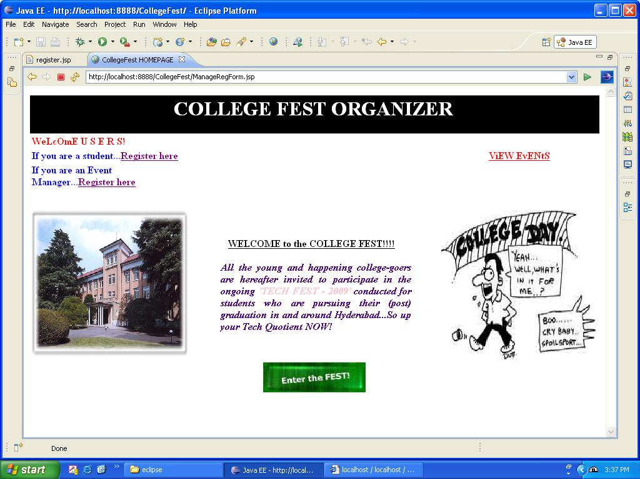
Homepage

Slide 16
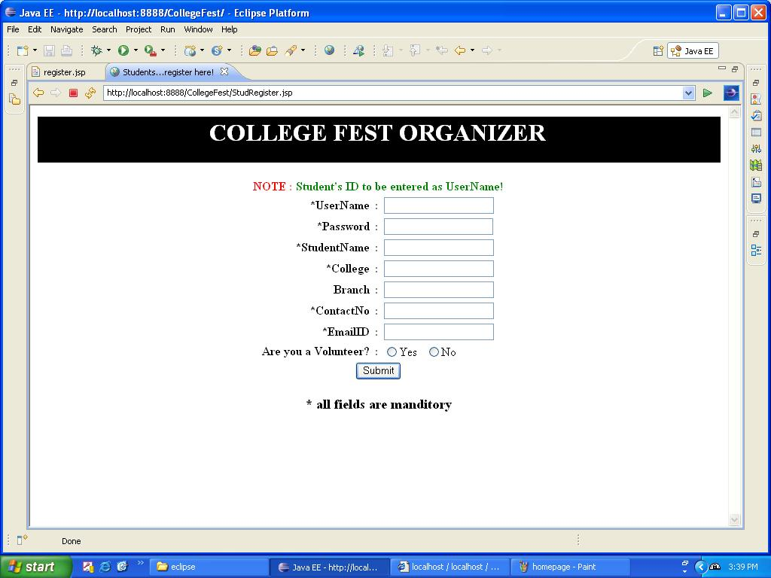
Student’s Registration Form

Slide 17
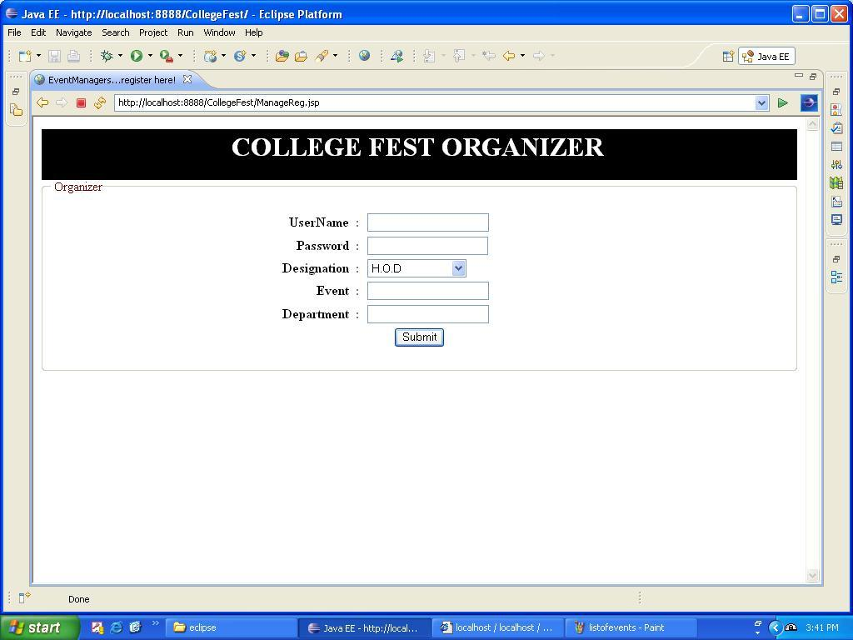
Organizer’s Registration

Slide 18
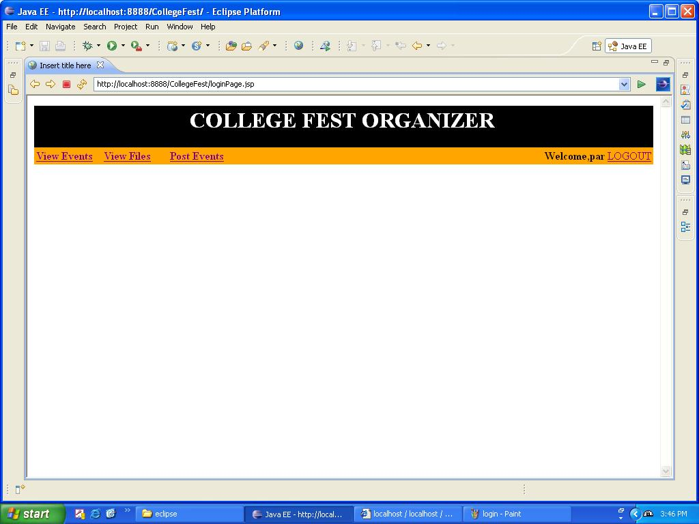
Organizer’s HomePage

Slide 19
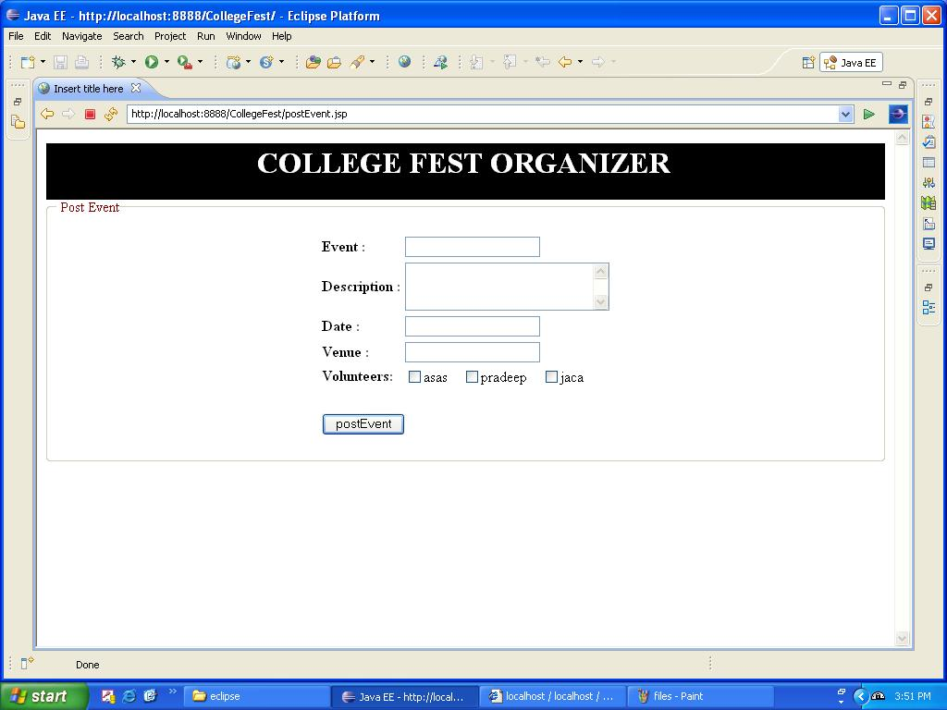
Posting Event

Slide 20
Conclusion
The College Fest Organizer project has been successfully completed. The goal of the system is achieved and the problems are solved. This project is developed in this manner that is user friendly and required help is provided at different levels.
The primary objective is to provide the interactive service to all the Users. Different types of services are provided to both the organizer and volunteers. User can avail this service any time.

